Slide 1
”””Exploring Data Warehousing Capabilities of NoSQL Systems for Big Data Analytics”””
3.2M Data : San Francisco Results

Slide 2
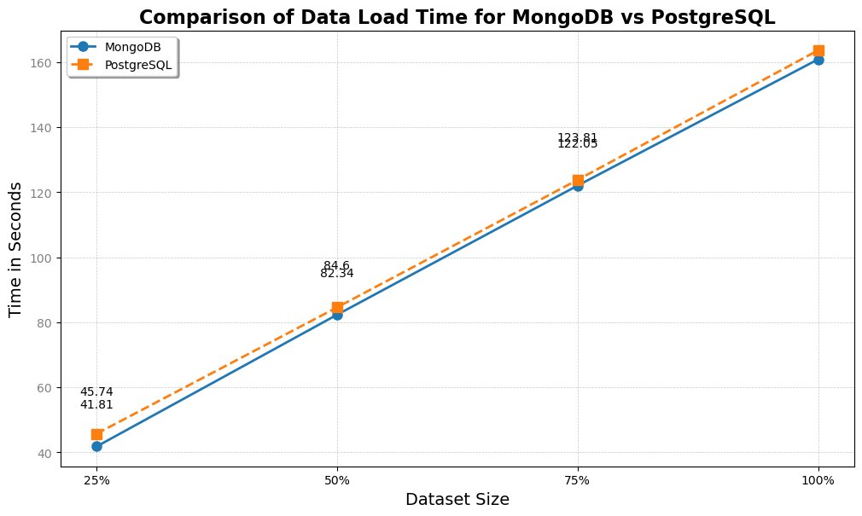
Insertion Time

Slide 3
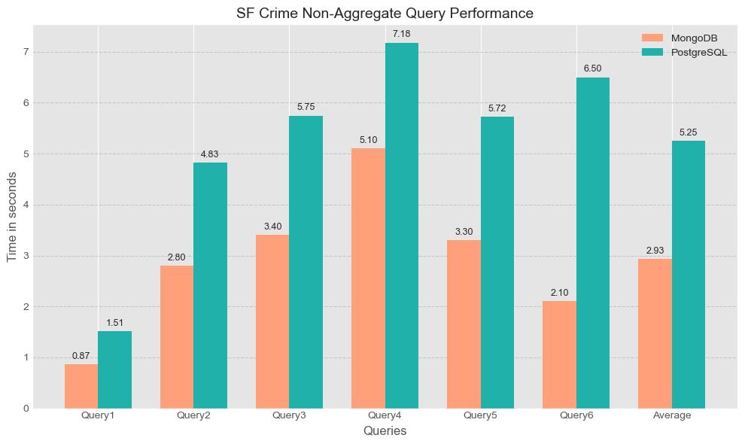
Non Aggregate Query Times (Crime)

Slide 4
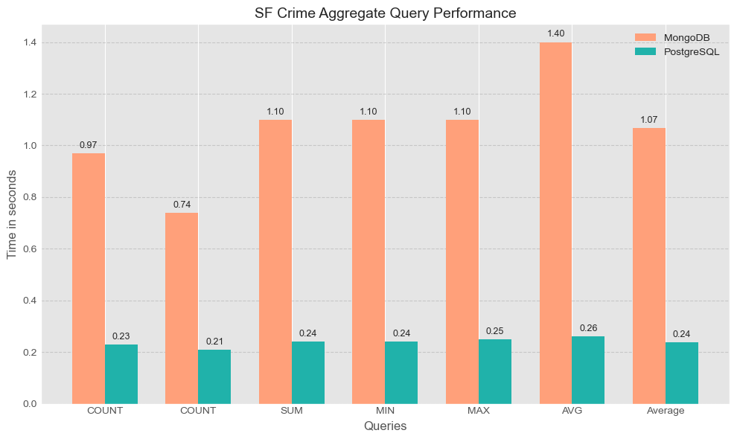
Aggregate Query Times (Crime)

Slide 5
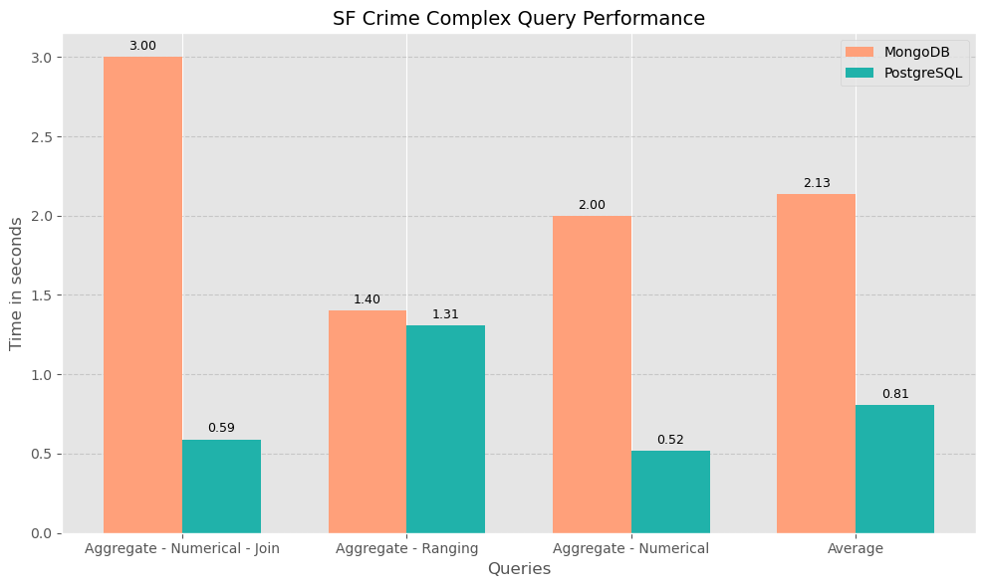
Complex Query Times (Crime)

Slide 6
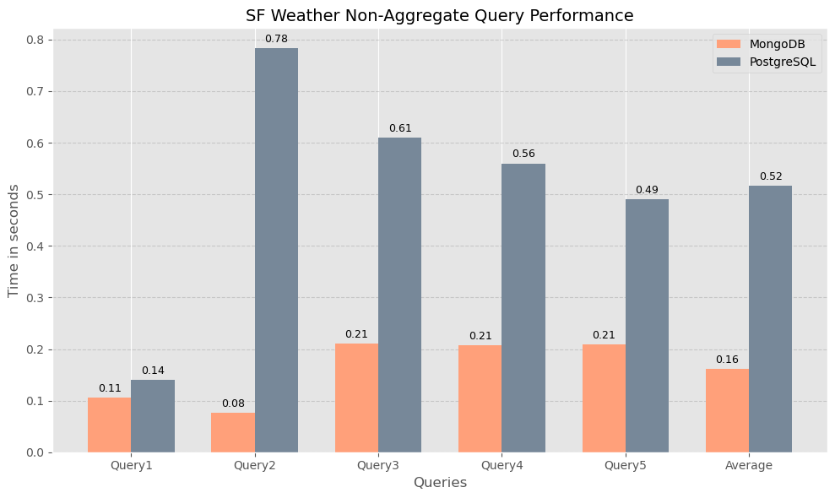
Non Aggregate Query Times (Weather)

Slide 7
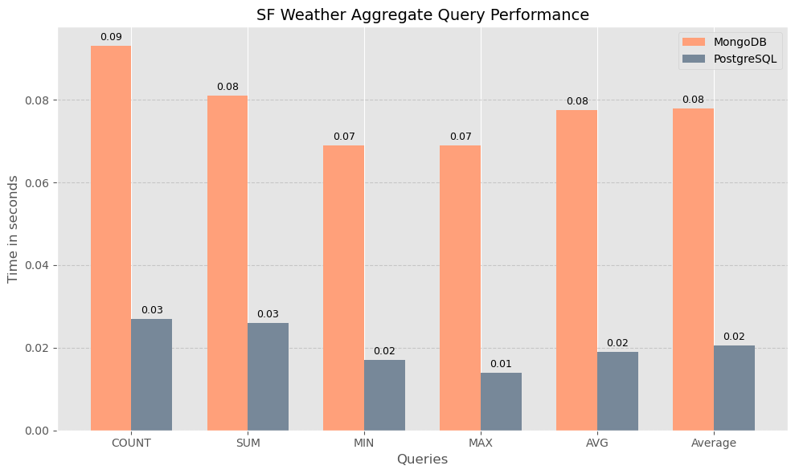
Aggregate Query Times (Weather)

Slide 8
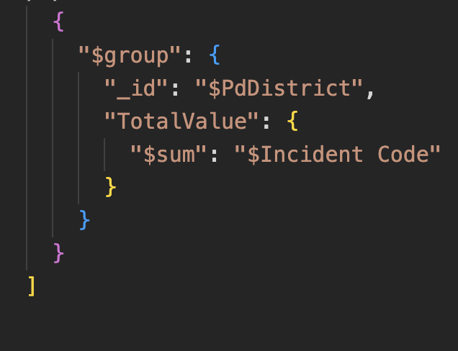
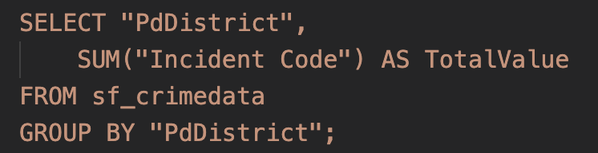
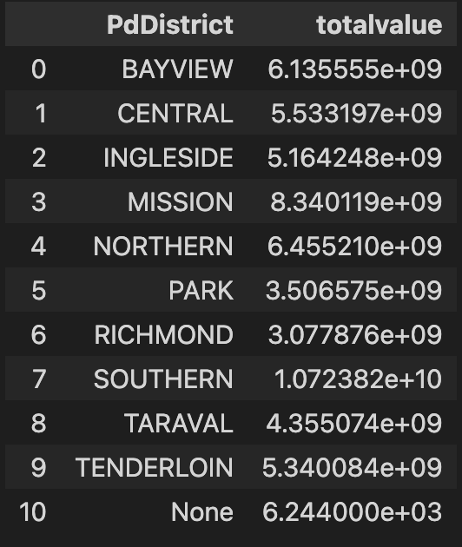
Example - SUM
SQL Query
MongoDB Query
Output

Slide 9
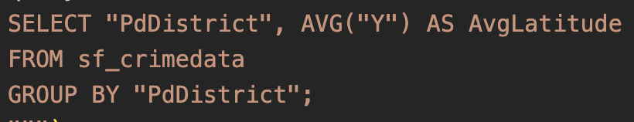
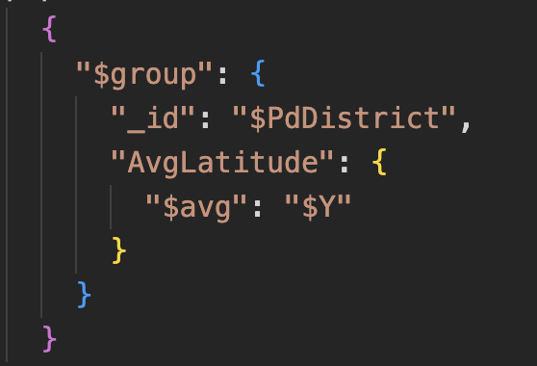
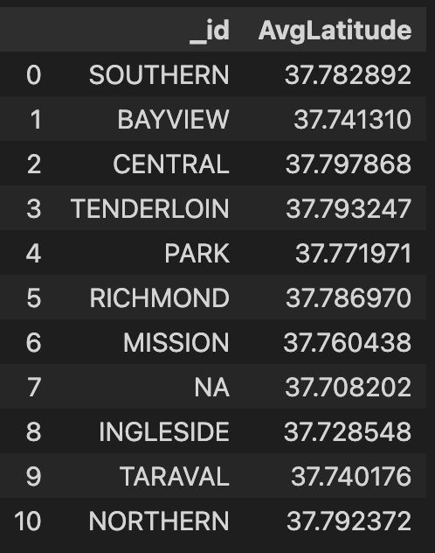
Example - AVG
SQL Query
MongoDB Query
Output

